Slide 1
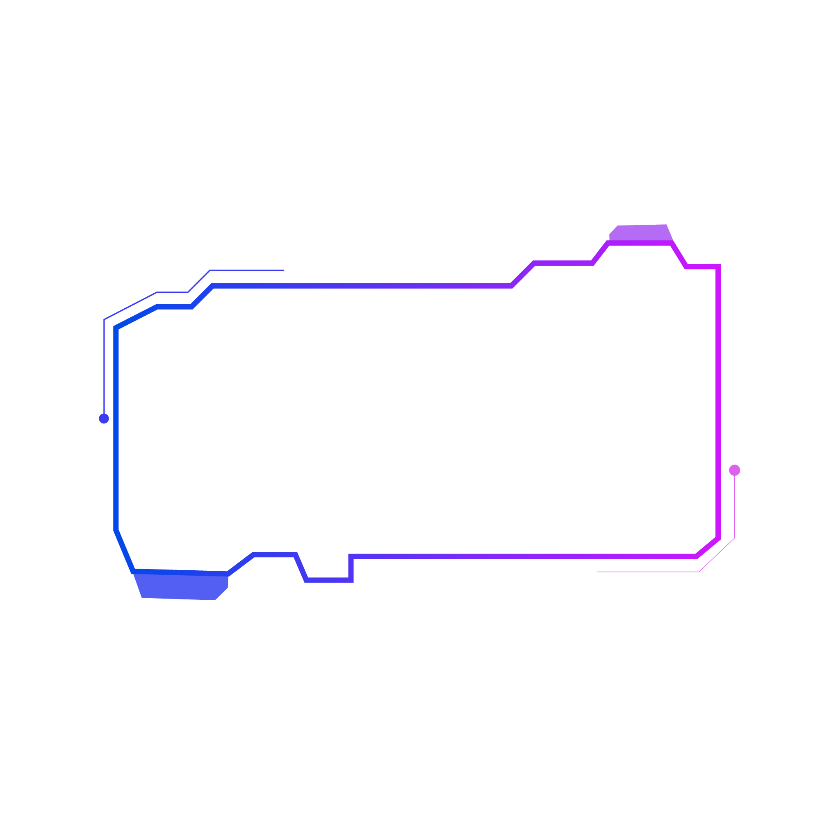


Strategic Business Information Technology
Strategic Analysis of Emerging Technology for Competitive Advantage
CA2
Charles Rocha - 2021376

Slide 2
What is Edge Computing?
i

Slide 3
Why Edge Computing is an Emerging Technology?
i

Slide 4


Use of Edge Computing – Amazon Go & Walmart

Slide 5
Competitive Advantage via Porter's Value Chain
i

Slide 6
Challenges & Limitations
i

Slide 7
Societal Impact of Edge Computing
i

Slide 8
Future Outlook
i

Slide 9
References
i

Slide 10

PART ONE

Slide 11

Enter title
Click here to add content of the text，and briefly explain your point of view.Click here to add content of the text，and briefly explain your point of view.Click here to add content of the text，and briefly explain your point of view.

Slide 12

PART TWO

Slide 13
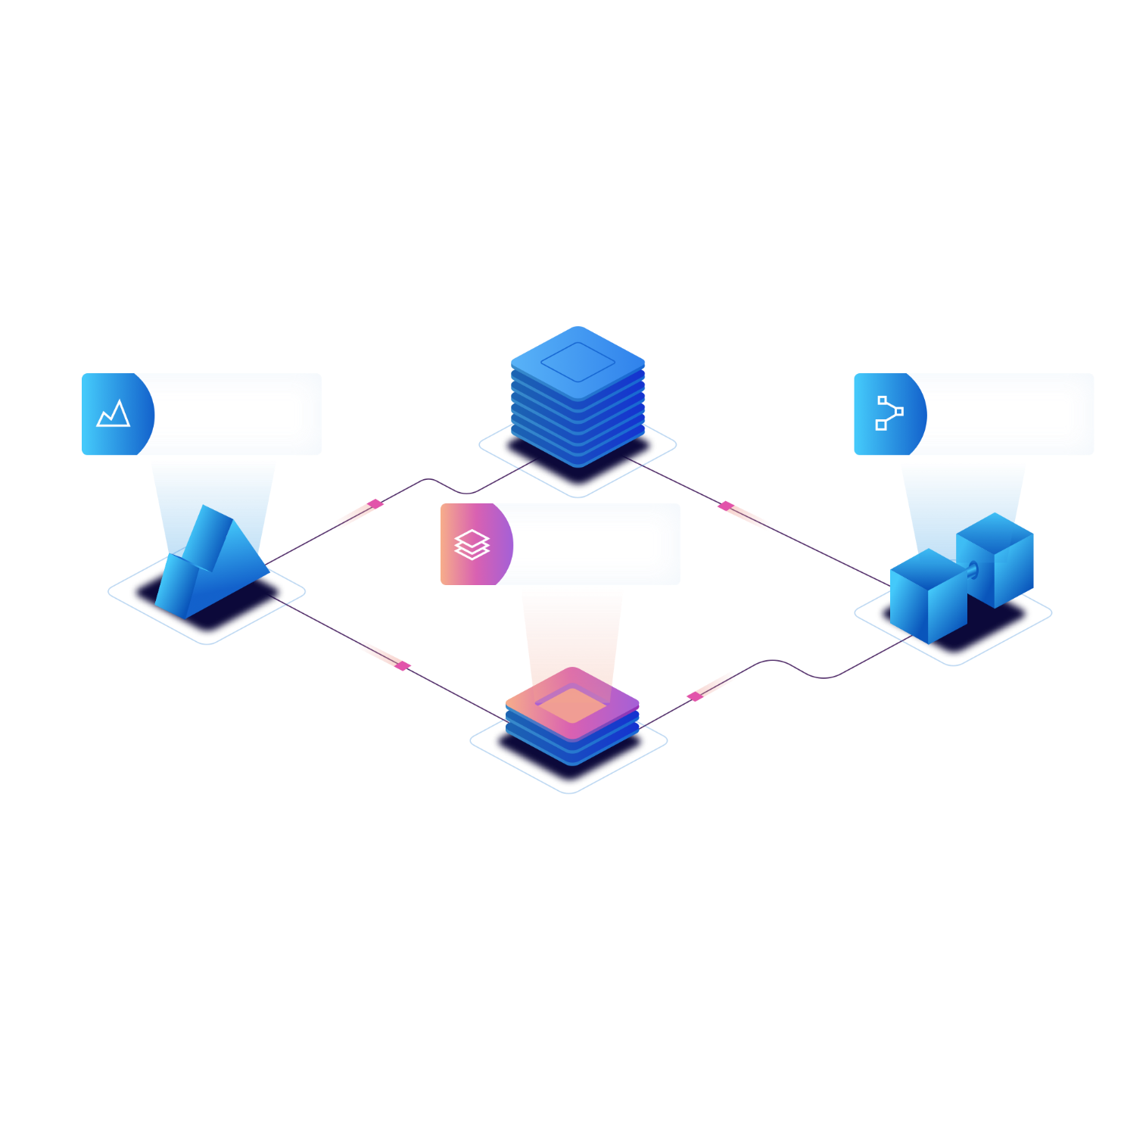
A
B
Enter title
Click here to add content of the text，and briefly explain your point of view.
Enter title
Click here to add content of the text，and briefly explain your point of view.

Slide 14

PART THREE

Slide 15


Enter title
Click here to add content of the text，and briefly explain your point of view.Click here to add content of the text，and briefly explain your point of view.

Slide 16

Enter title
Click here to add content of the text，and briefly explain your point of view.Click here to add content of the text，and briefly explain your point of view.
Enter title
Click here to add content of the text，and briefly explain your point of view.Click here to add content of the text，and briefly explain your point of view.
Enter title
Click here to add content of the text，and briefly explain your point of view.Click here to add content of the text，and briefly explain your point of view.

Slide 17
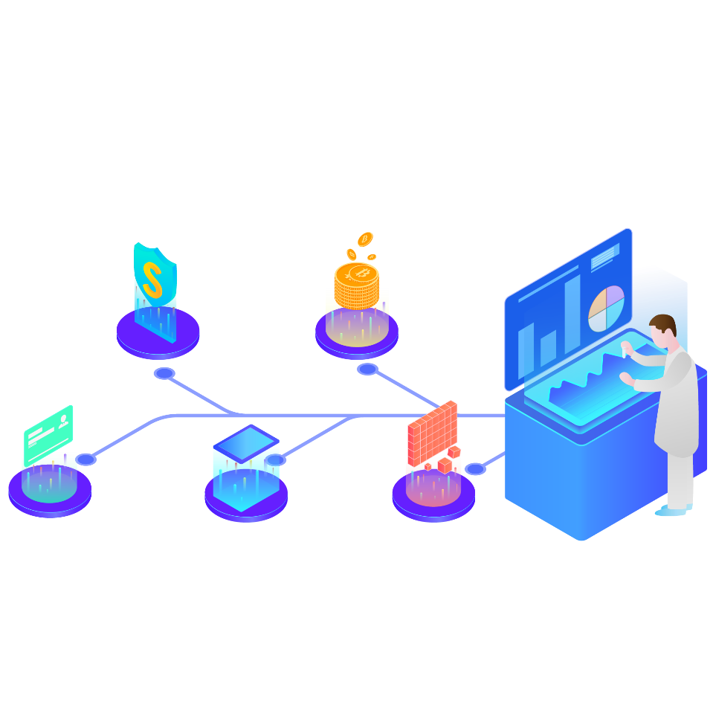
PART FOUR

Slide 18


Enter title
Click here to add content of the text，and briefly explain your point of view.
100%

Slide 19
THANKS

Slide 26
References

